Slide 1

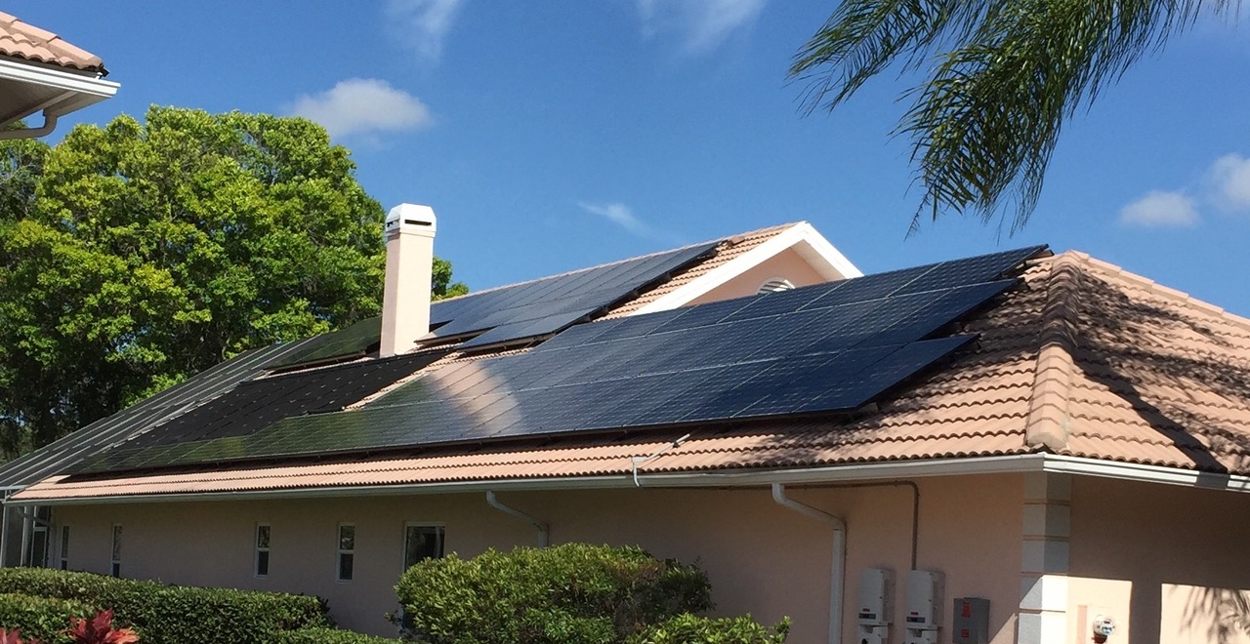

Green Corridor/Miami-Dade Report

Slide 2
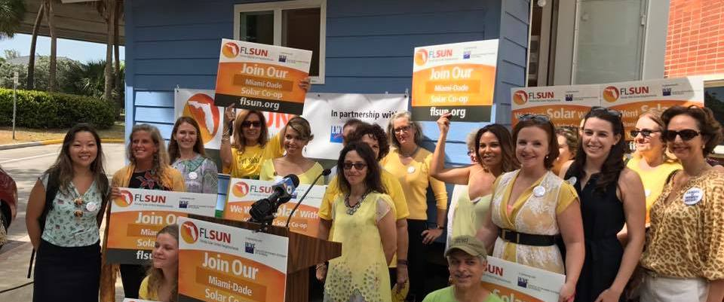



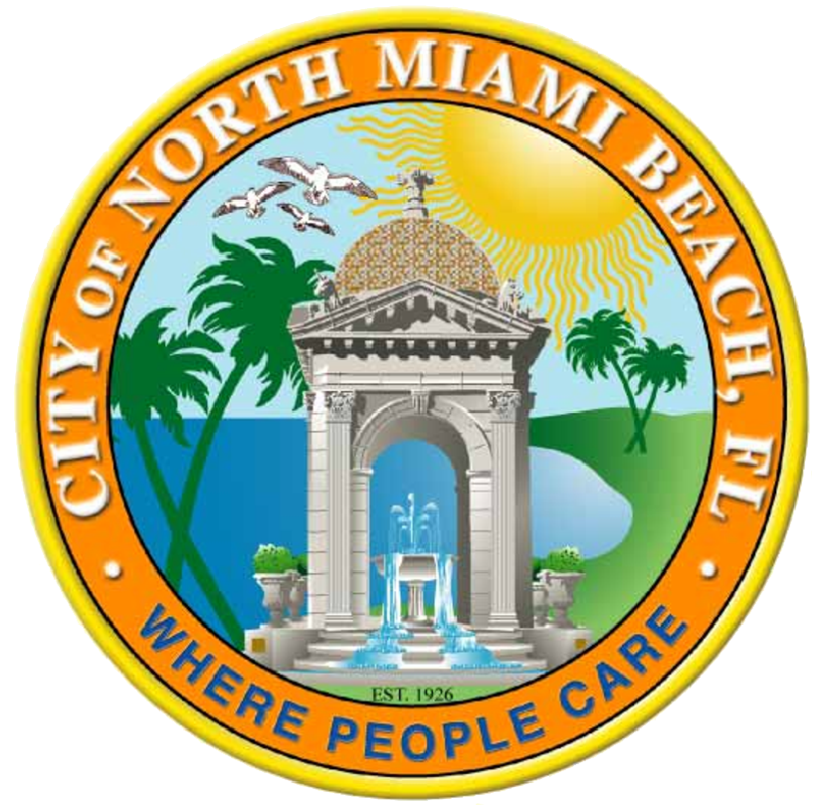



New Partners and Outreach

Slide 3
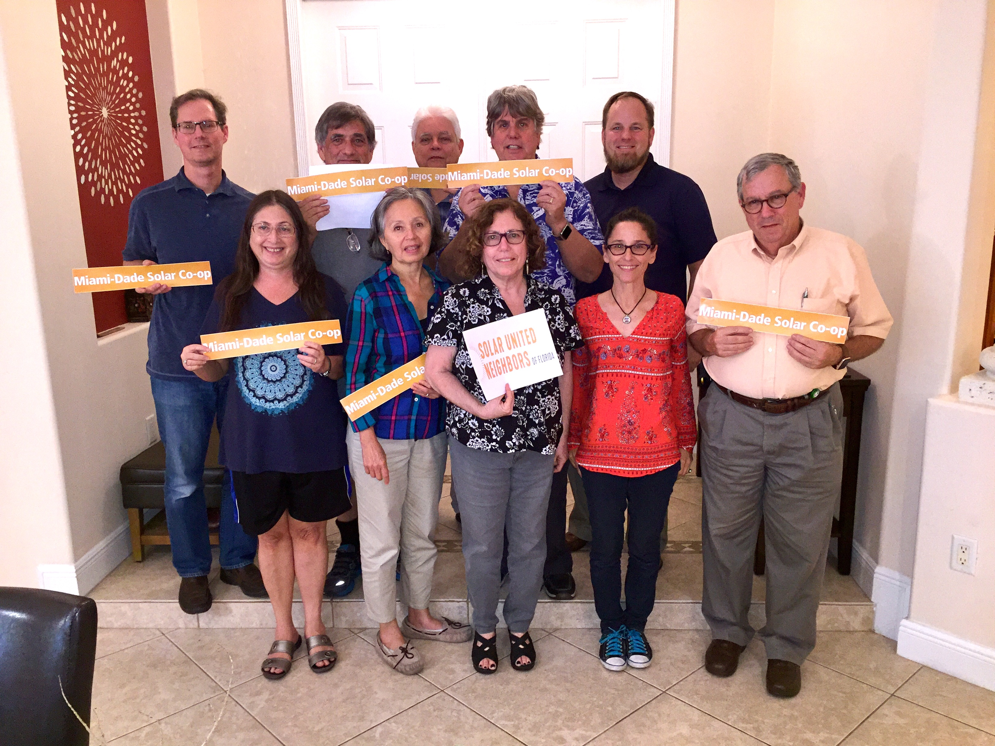
Key stats for Southern Miami-Dade
4 information sessions
  Palmetto Bay
  Cutler Bay
  Palmer Trinity
  Temple Beth Am – private event
  Homestead MDC
412 info session RSVPs
109 participants
11 contracts (ongoing)
1 completed install
Southern Miami Dade
Selection Committee

Slide 4
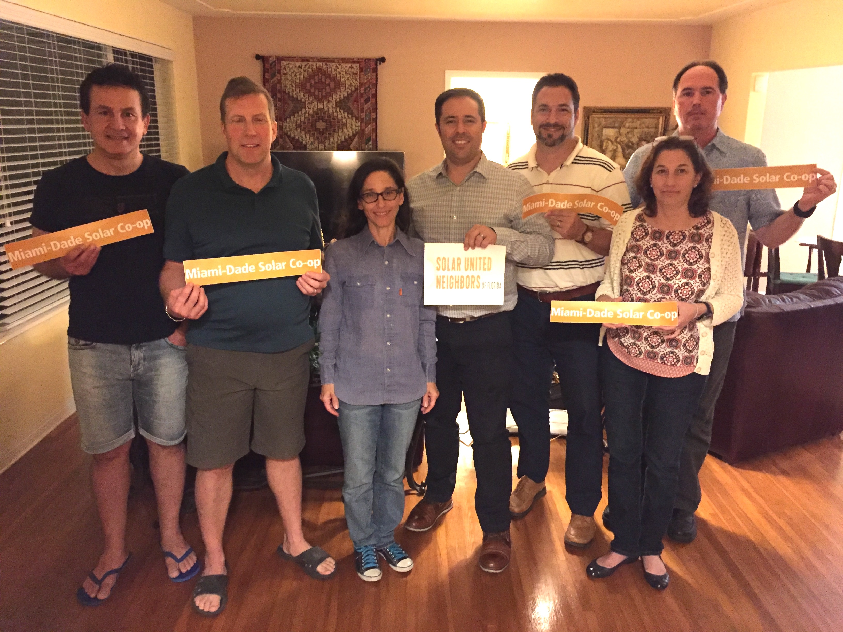
Key stats for Northern Miami-Dade
4 information sessions
  Miami Shores
  MDC North Campus
  Chabad Chayil
  Miami Lakes
270 info session RSVPs
63 participants
3 contracts (ongoing)
Northern Miami Dade
Selection Committee

Slide 5
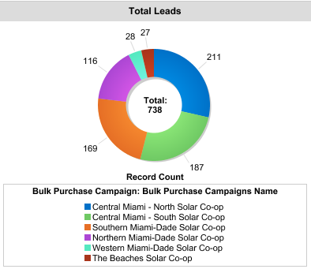
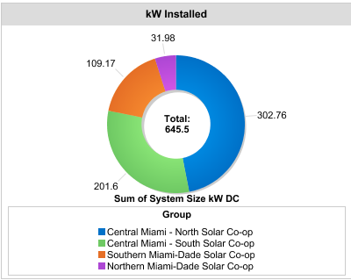
738 co-op participants to-date

Slide 6
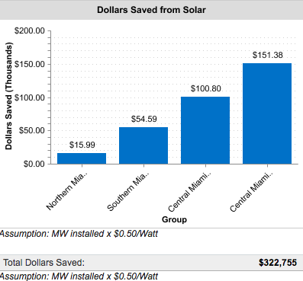
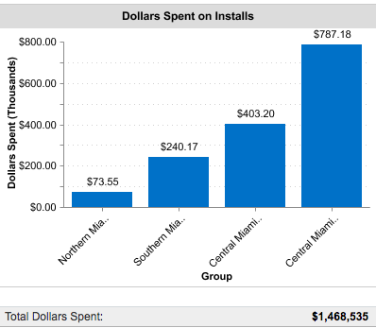
Dollars spent and saved

Slide 7
Explaining the tariff
The Sky is not falling. The sun is still out.
30% tariff on imported solar panels
Only about 10-15 cents/watt (estimated)
Average 7kW system = $1,050 or $735 after tax credit. GO SOLAR!
Tariff drops down over next four years
2018 – 30%
2019 – 25%
2020 – 20%
2021 – 15%
Source: NREL

Slide 8
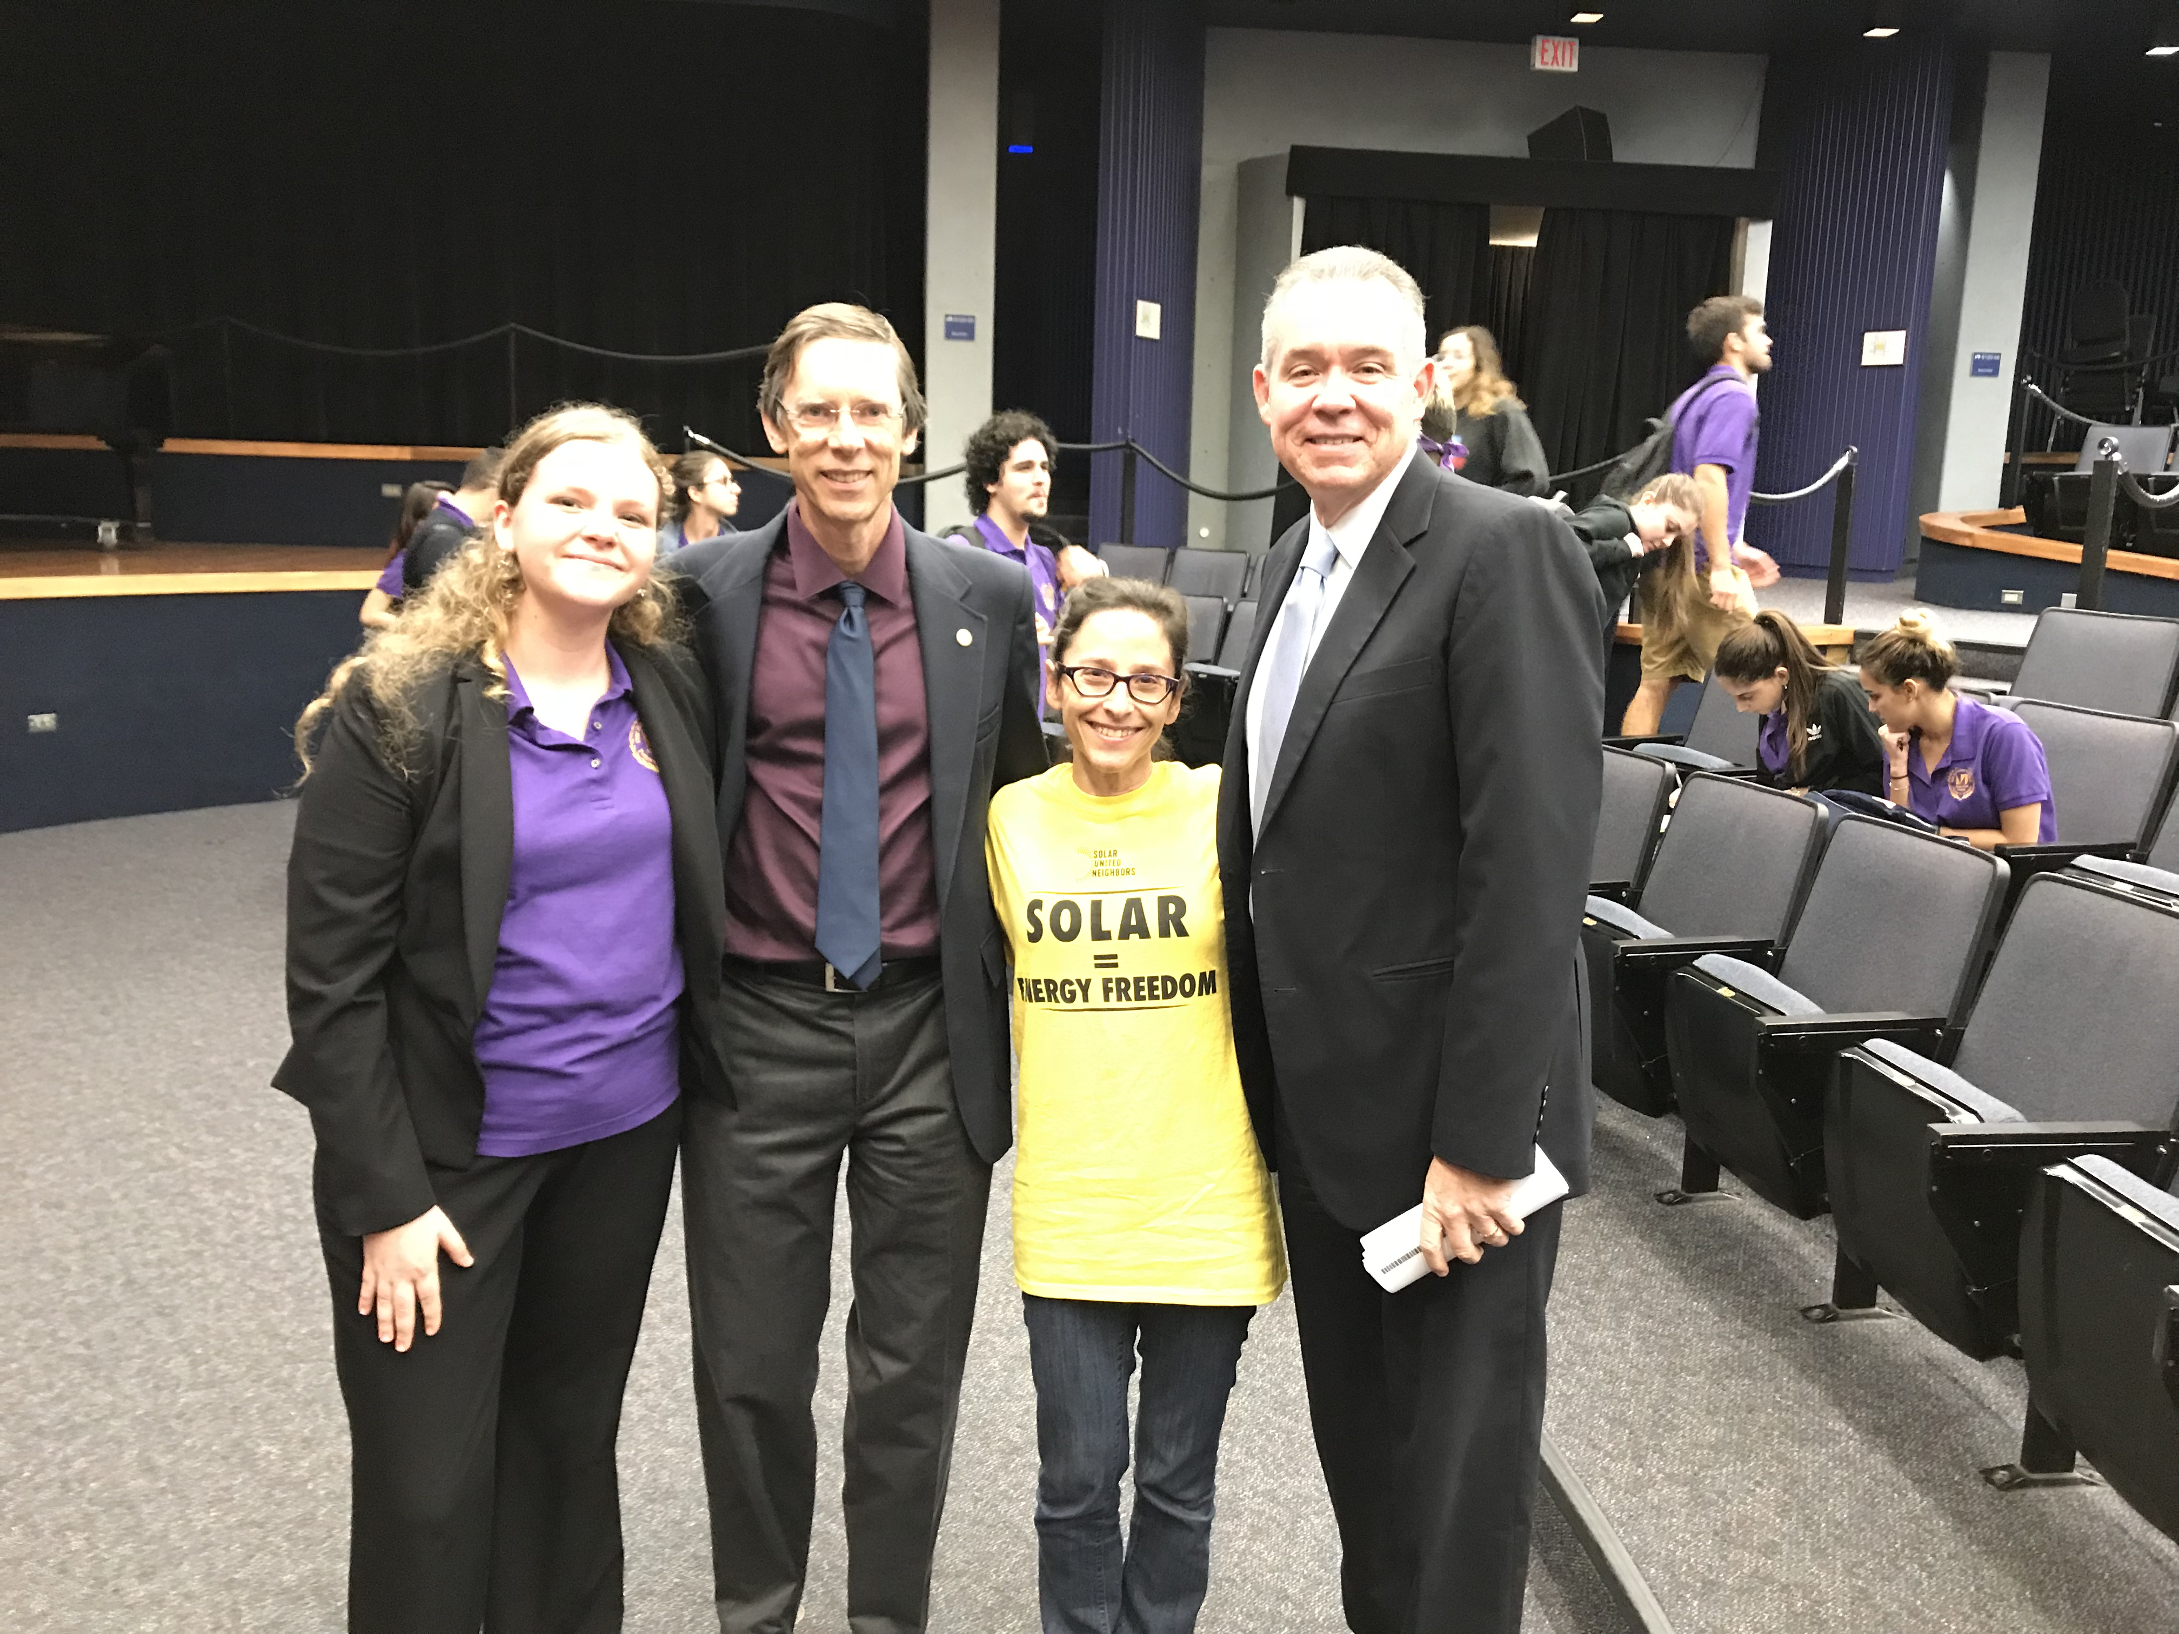
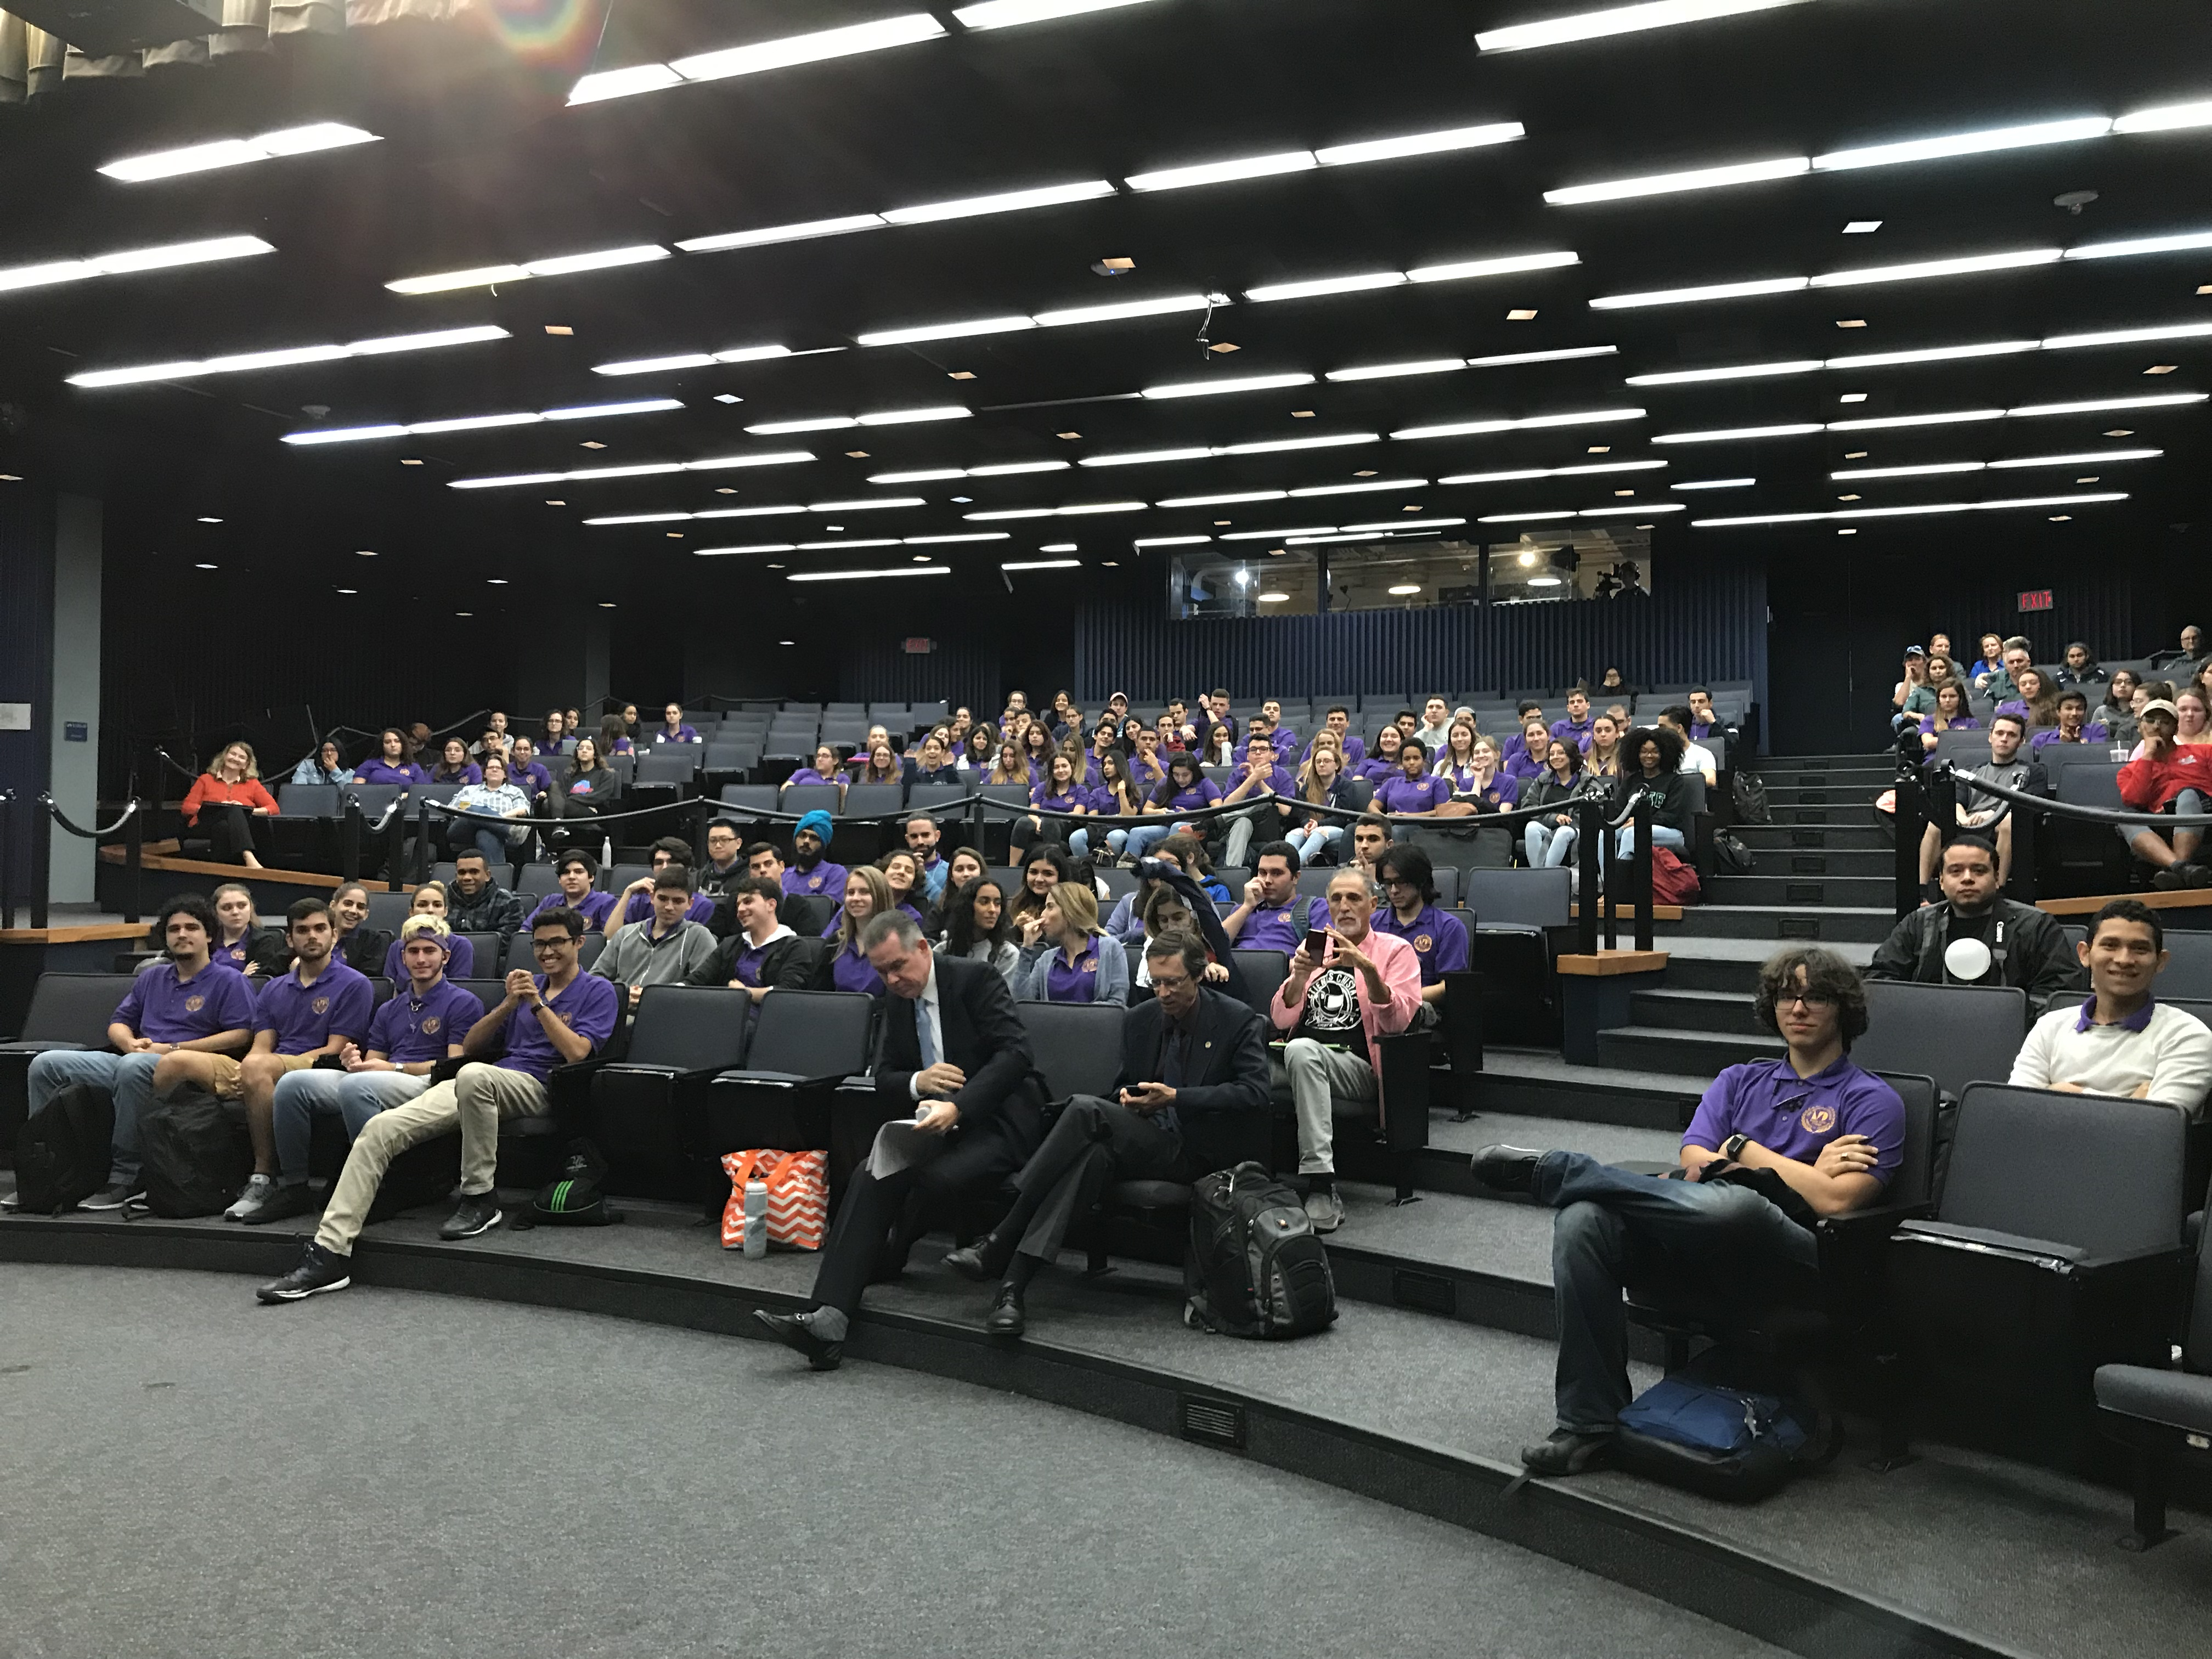
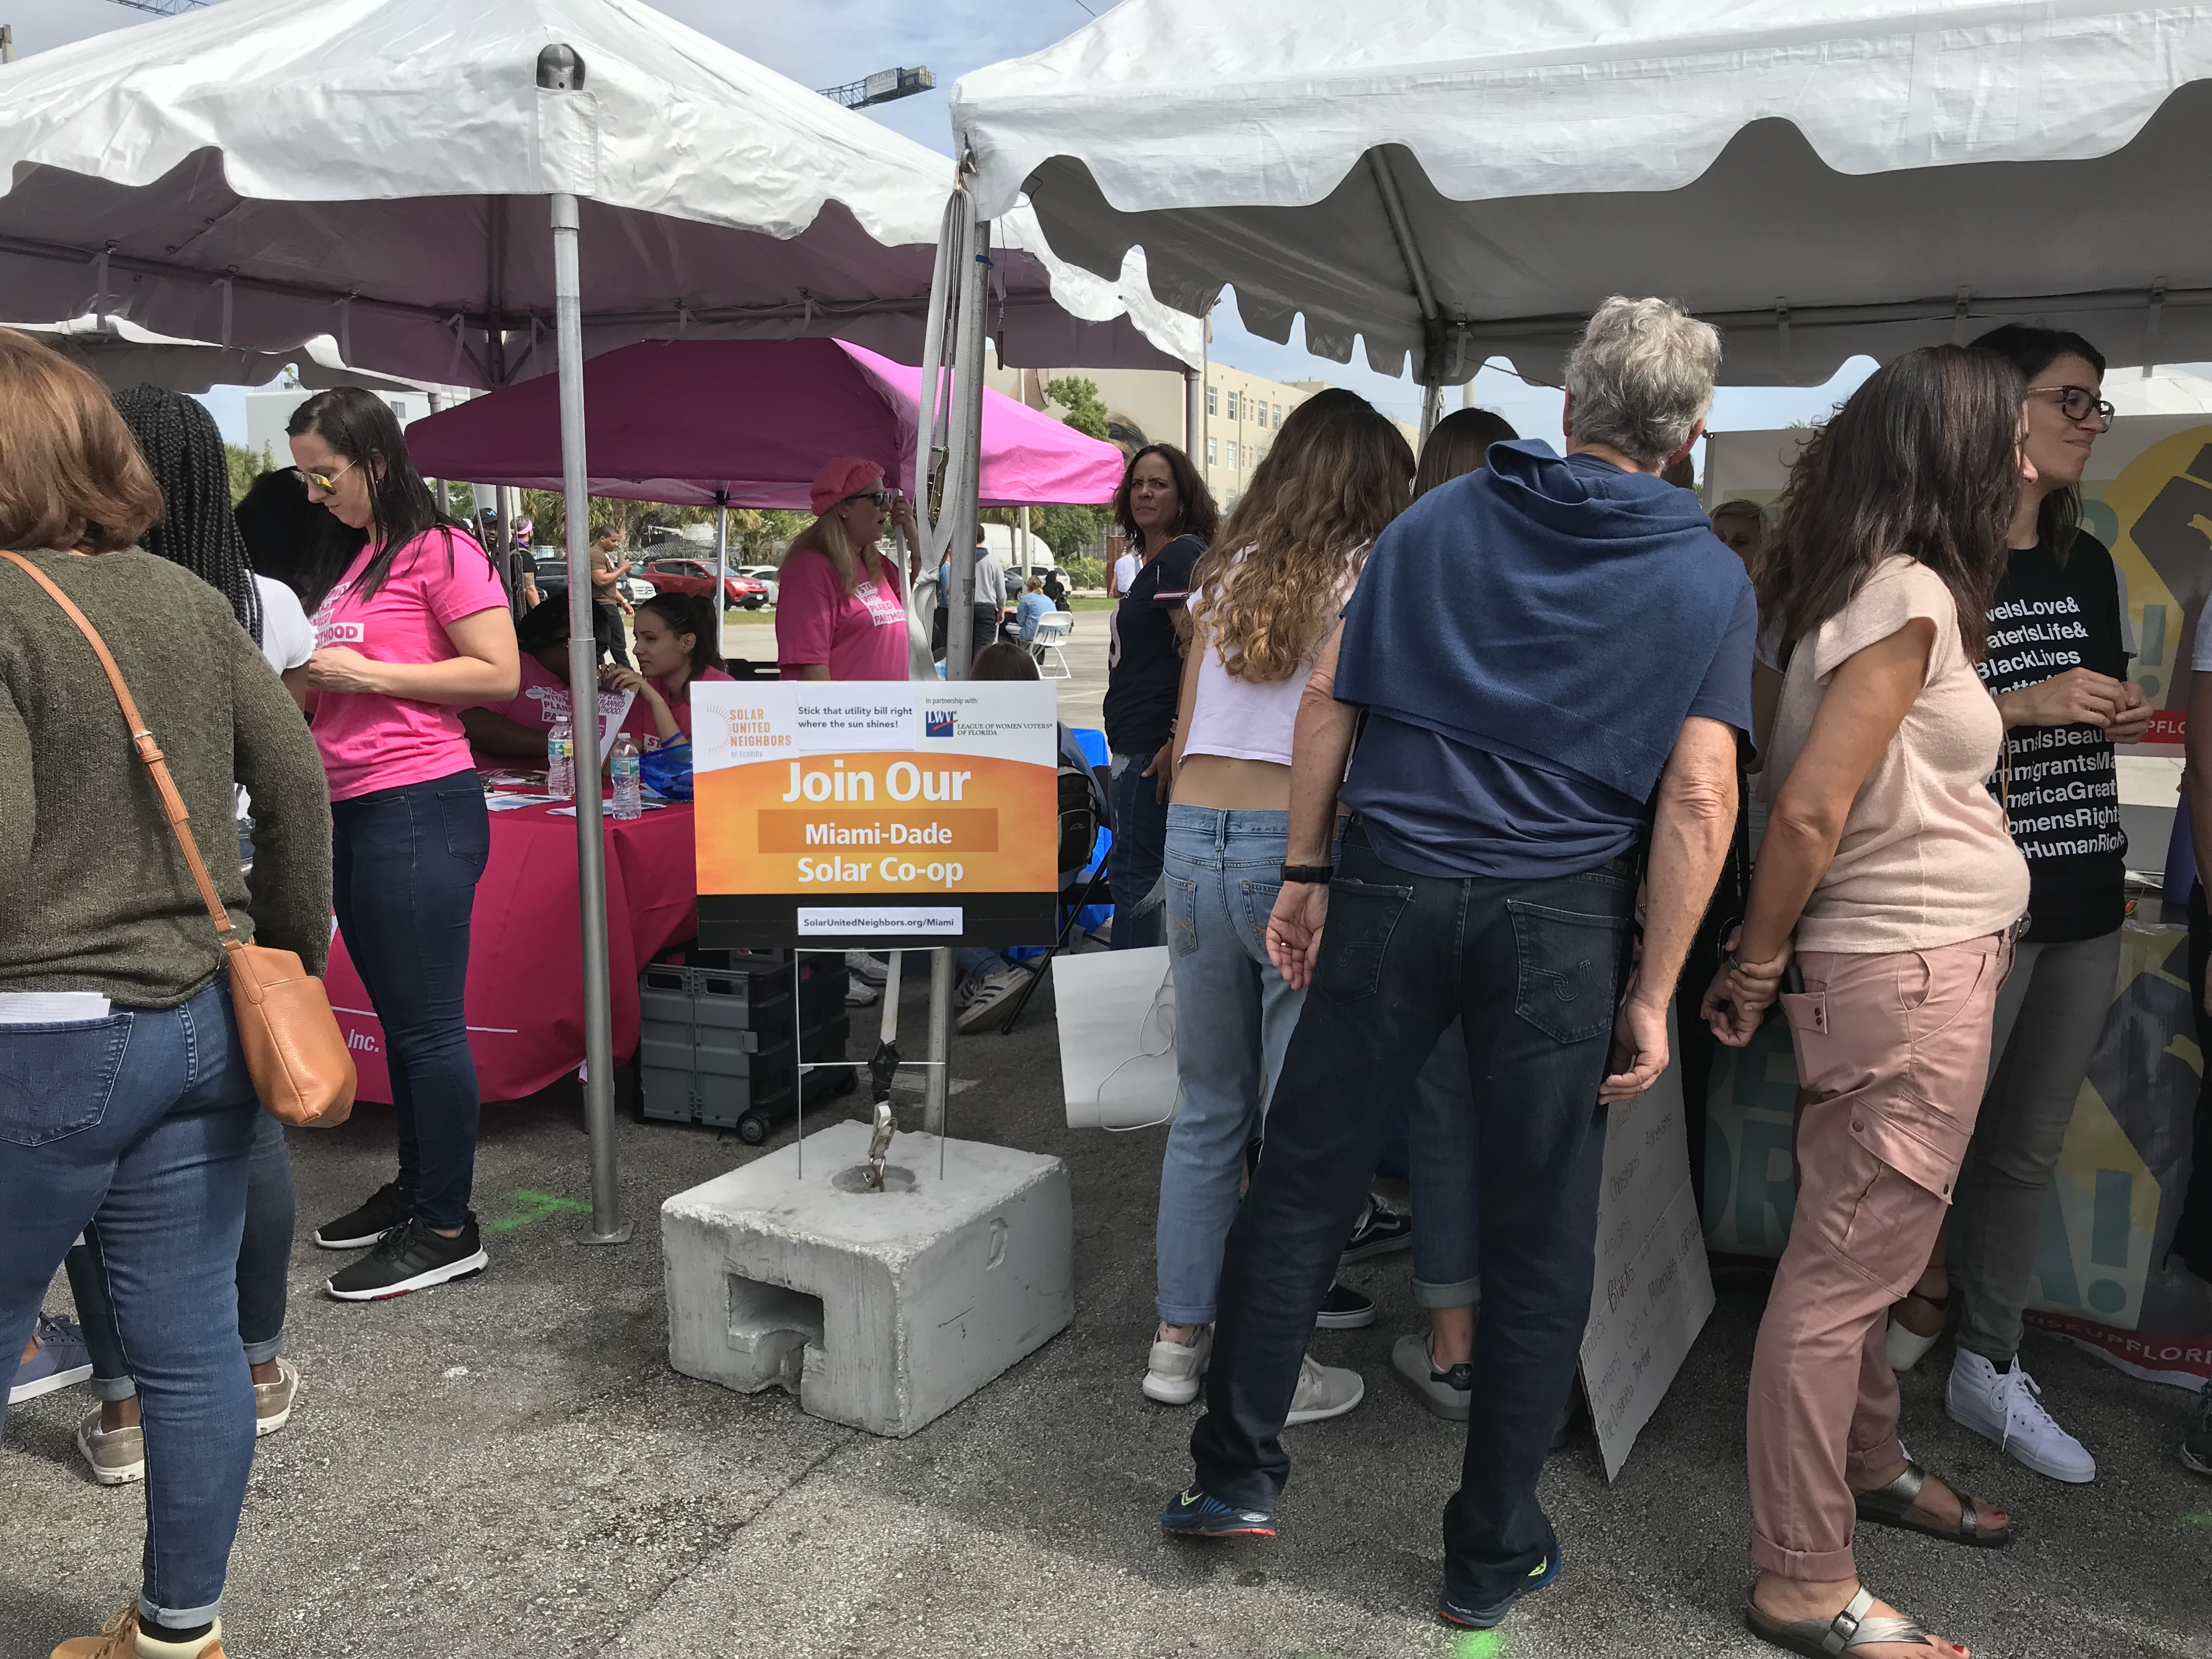
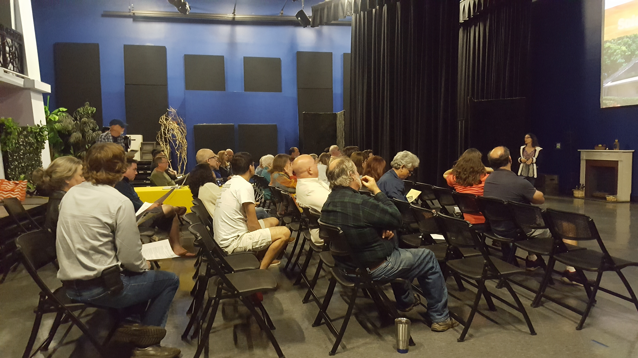
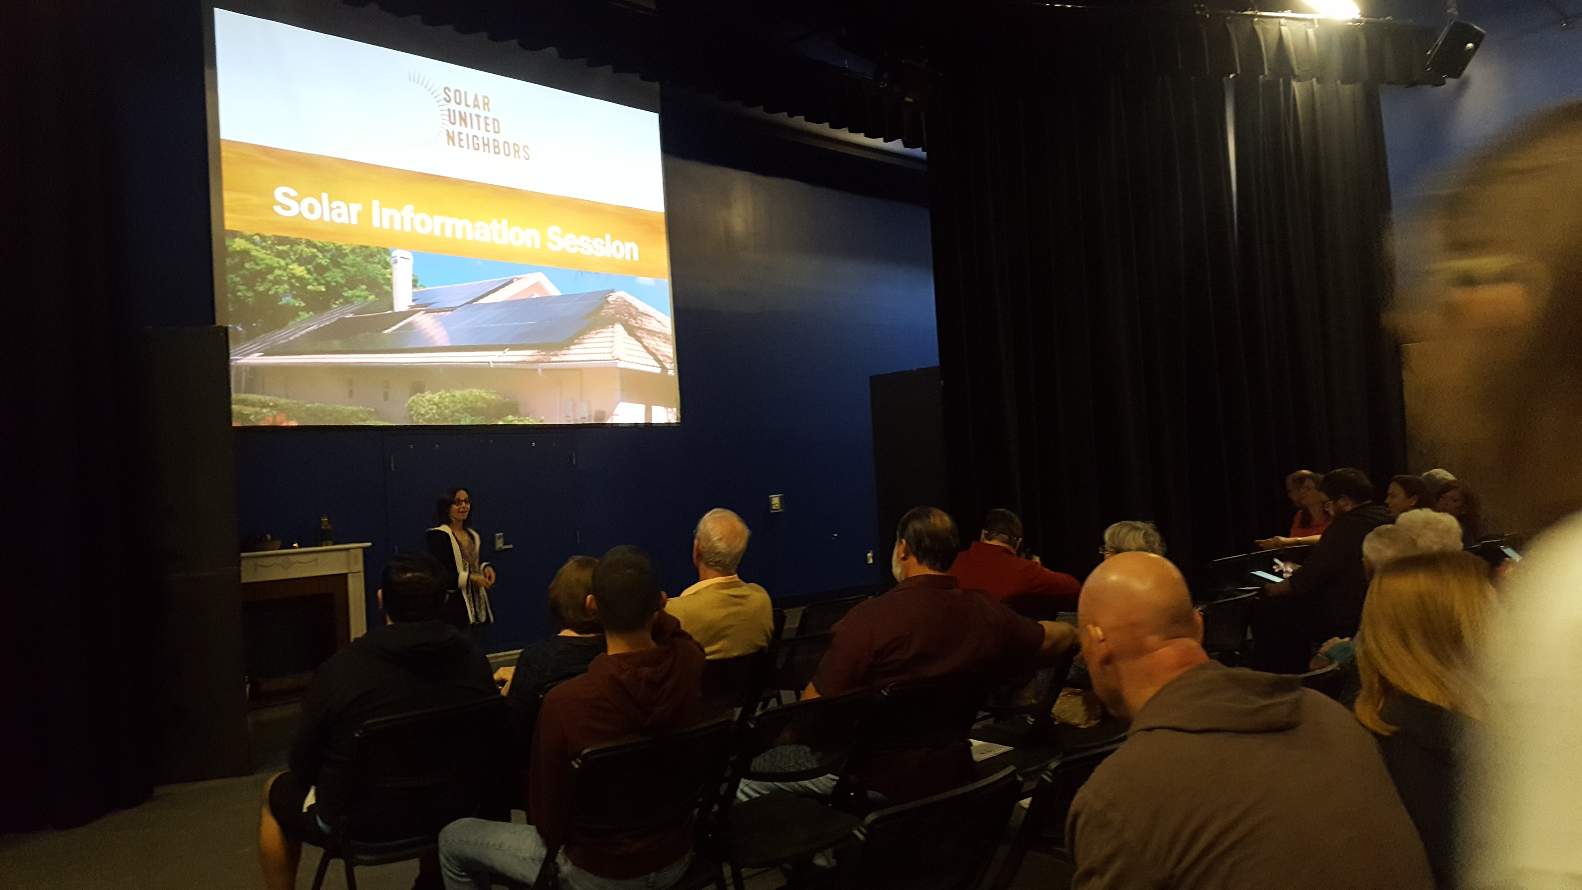
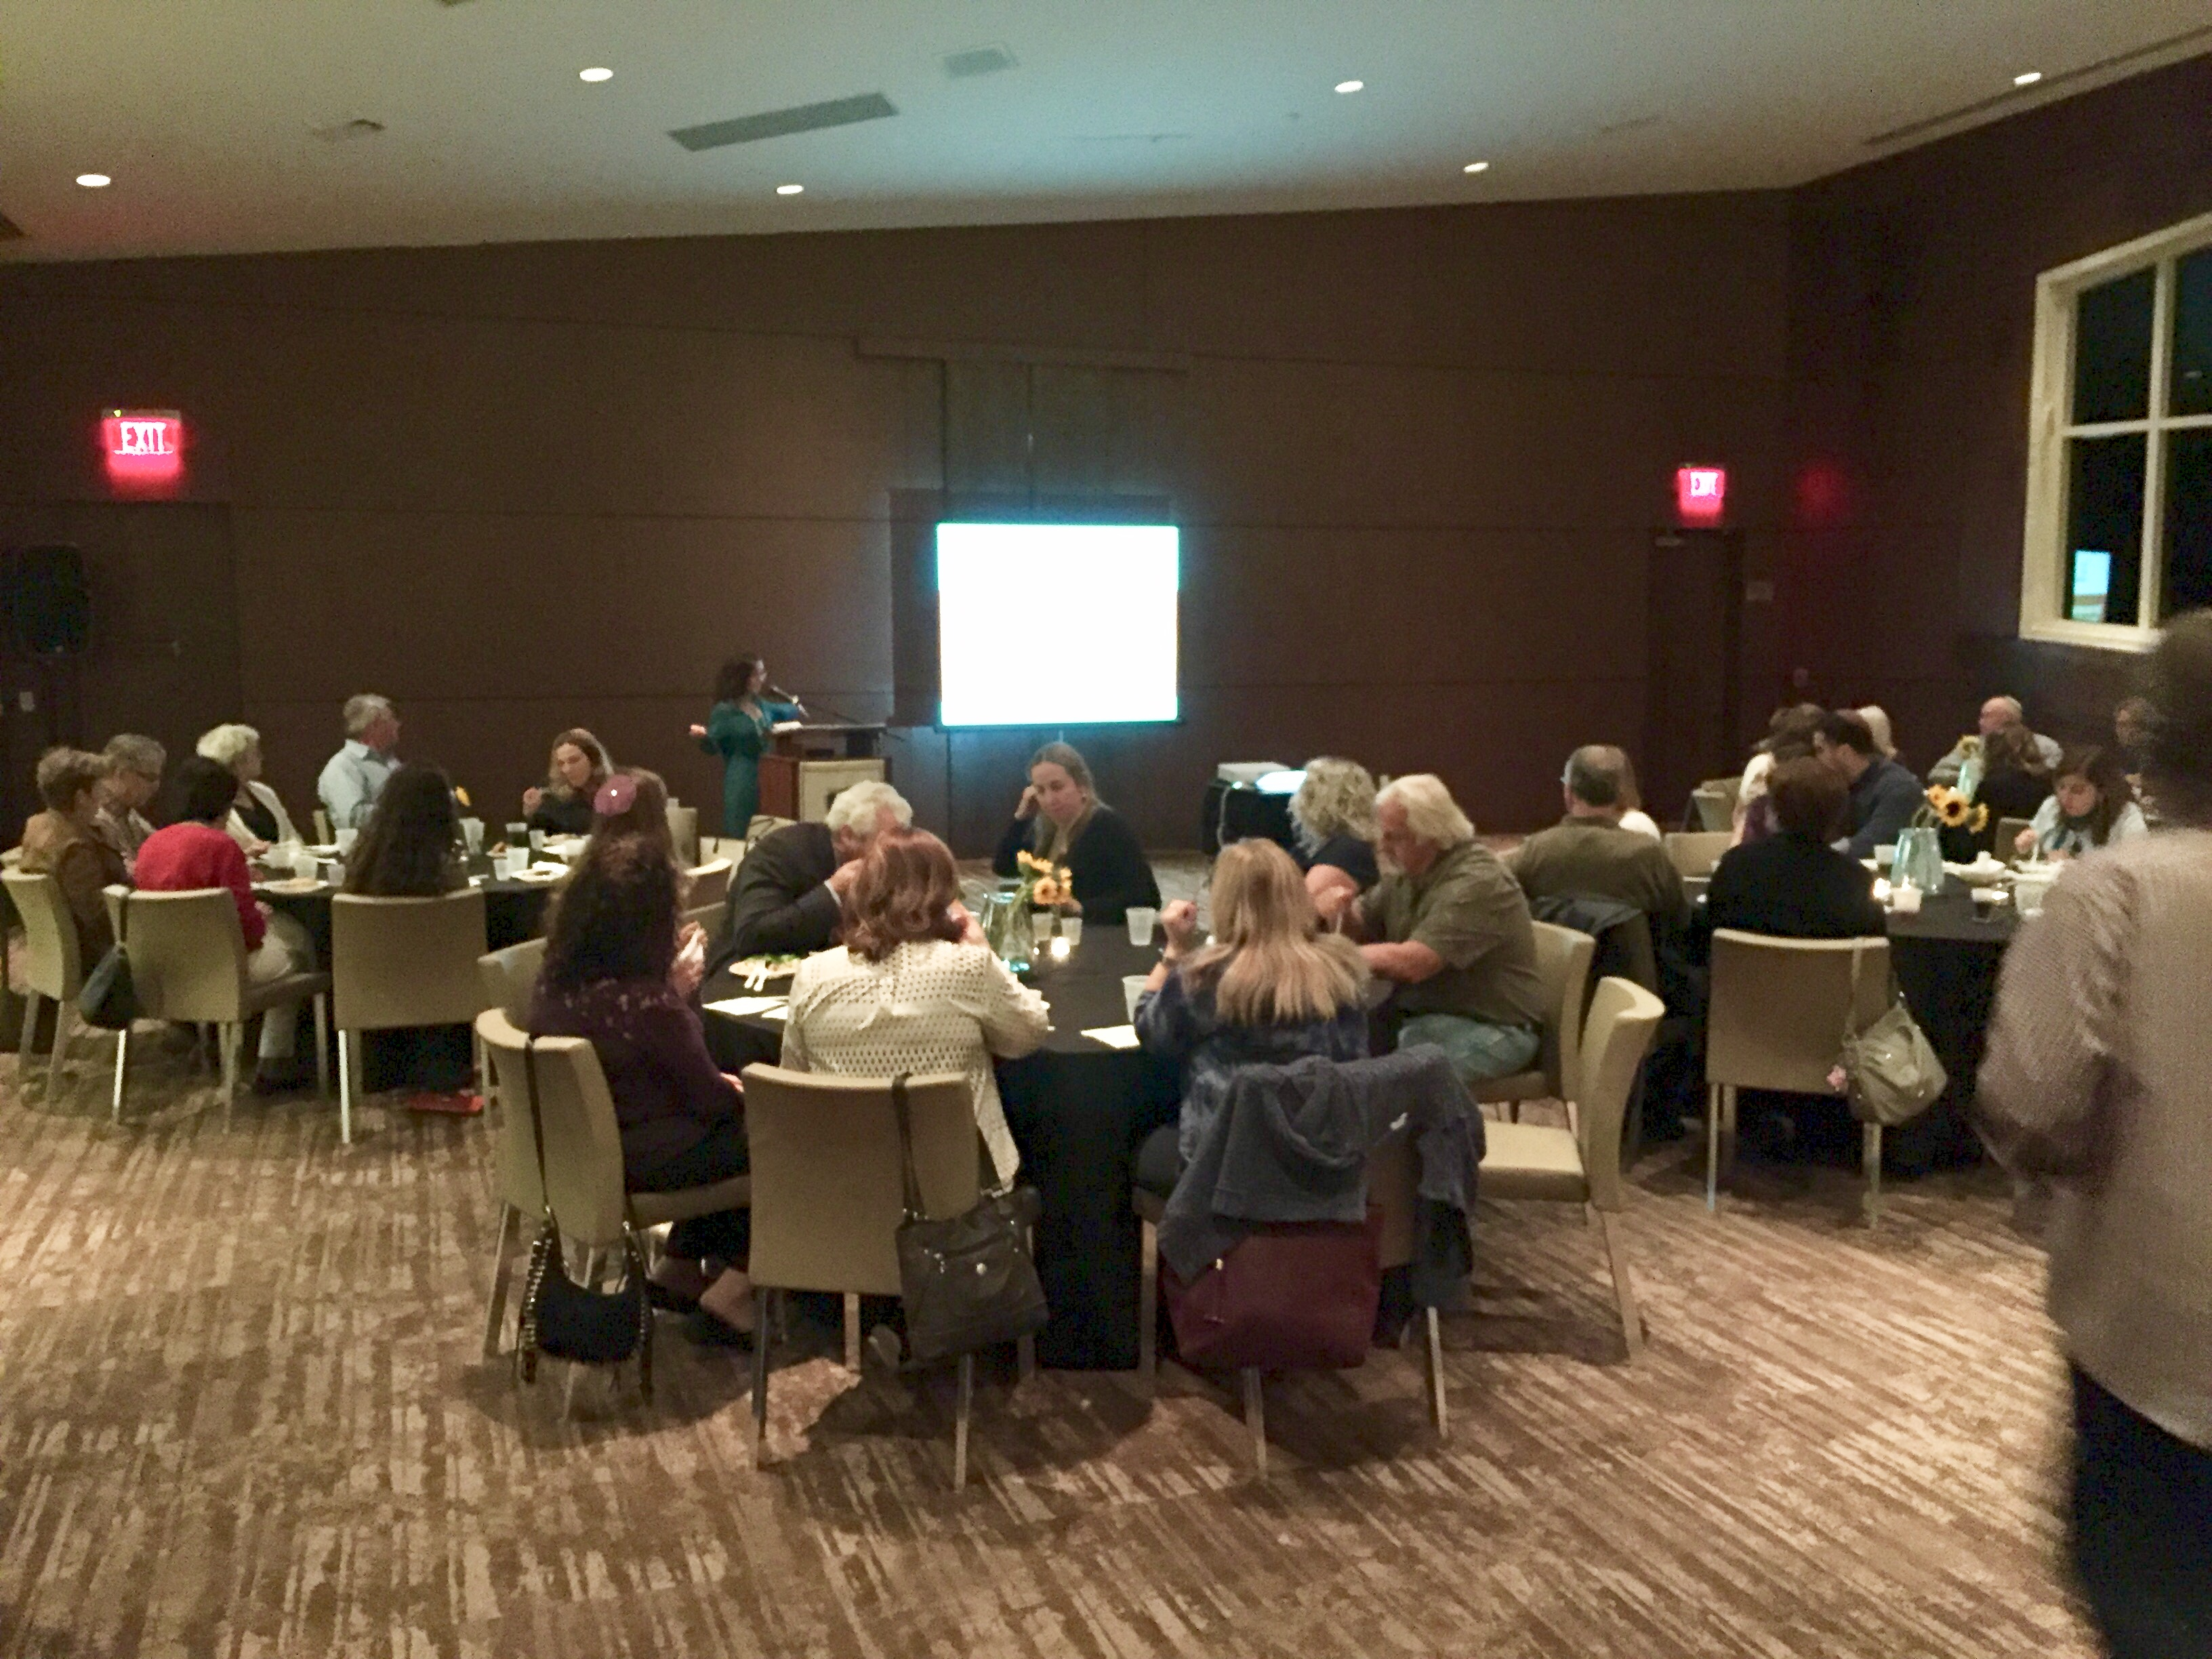
Solar Education and Outreach
Climate Solutions MDC Honors College Forum, partner tabling, current
co-op information sessions and special request presentations

Slide 9
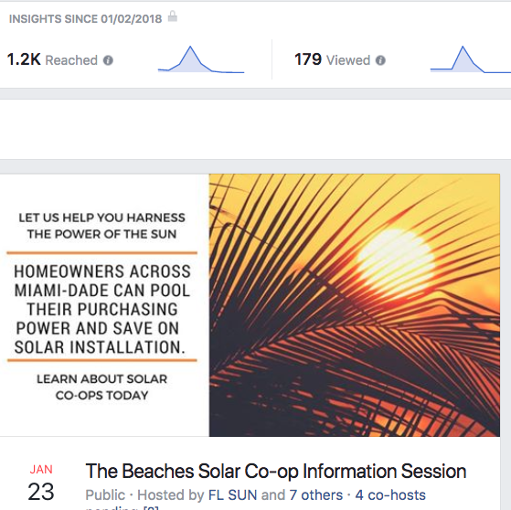
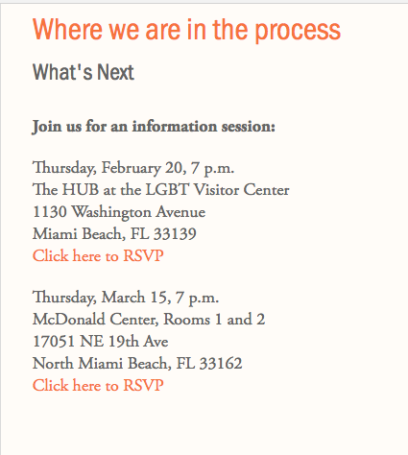
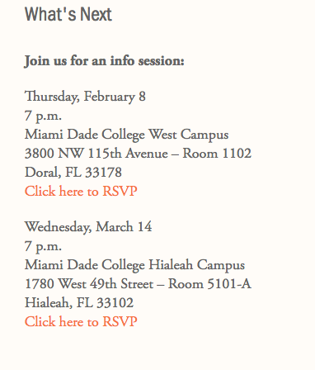
Promoting Current Info Sessions
Events actively promoted via Facebook, partner newsletters, commissioner e-blasts, newspaper placement through municipalities, NextDoor and tabling events.
378 VOLUNTEERS RECRUITED TO SPREAD THE SUNSHINE!

Slide 10
Community-wide support for effort
Palmetto Bay waives permitting fees (Vote 3/18)
Cutler Bay reduces fees by 65%
Miami Springs waives permitting fees
Doral waives permitting fees
Surfside waives permitting fees
Miami Beach waives permitting fees.
Miami-Dade County revisiting SolSmart and establishing workshops for installers and reviewers
(New cities waiving fees join: Coral Gables, City of Miami, South Miami, Miami Shores)

Slide 11
New Co-Ops
Western Miami-Dade
Miami Springs, Doral, Westchester, City of Hialeah and unincporporated Miami-Dade to western county line from SW 42nd Streeet to northern tip of Hialeah.
3 scheduled info sessions
13 qualified homes
The Beaches
Aventura, Bal Harbor, Eastern Shores, Golden Beach, Miami Beach, North Bay Village, North Miami Beach, Sunny Isles Beach and Surfside.
4 scheduled info sessions.
15 qualified homes

Slide 12
Go Big or Go Home
Looking at RSVPs, homeowners still working with insurance companies to resolve Hurricane Irma damage, volunteer fatigue, as well as numerous emails, calls and requests from homeowners outside the current co-op territory, we are going to consolidate the two existing co-ops and open the
co-op up to all residents in the county.
We planned and developed six co-ops, but are not satisfied with the current numbers. We will be able to engage more residents, volunteers and outreach by not just merging the territories of co-ops five and six, but making this one a county-wide all inclusive effort.
Similar to all our other county programs, this will be open to all homeowners including those that were not able to obtain estimates or go solar in our
four previous co-ops.
EVERYONE IS WELCOME!

Slide 13
Moving forward: new co-ops
County co-ops are meant to be limited-time offerings. There are often year gaps between them. Strategizing future co-ops, to keep them special in the eyes of homeowners, I would like to launch co-ops within existing organizations rather than repeat previous co-op groupings. This would simplify locating info session venues and attract new partners.
Some ideas (just ideas) I have had are:
Miami-Dade Public School Employees – info sessions to take place in schools
Miami-Dade County Workers – all workers, or firefighters, police, etc
Miami-Dade College Employees – info sessions to take place on campus
Boys Scouts of South Florida – Troops to promote co-ops and work toward solar Patch Program
1199SEIU – Healthcare workers - information sessions to take place in hospitals
Green Corridor municipal employees – well, hello there. Got a city hall?
County-Wide Co-Op and Level 2 charging
These would attract all demographics and incomes. If police, firefighters, schools or scouts were to have co-ops, it could also allow for competition ie: the school with the most sign ups gets a free solar canopy array which would be donated by the co-op installer.

Slide 14

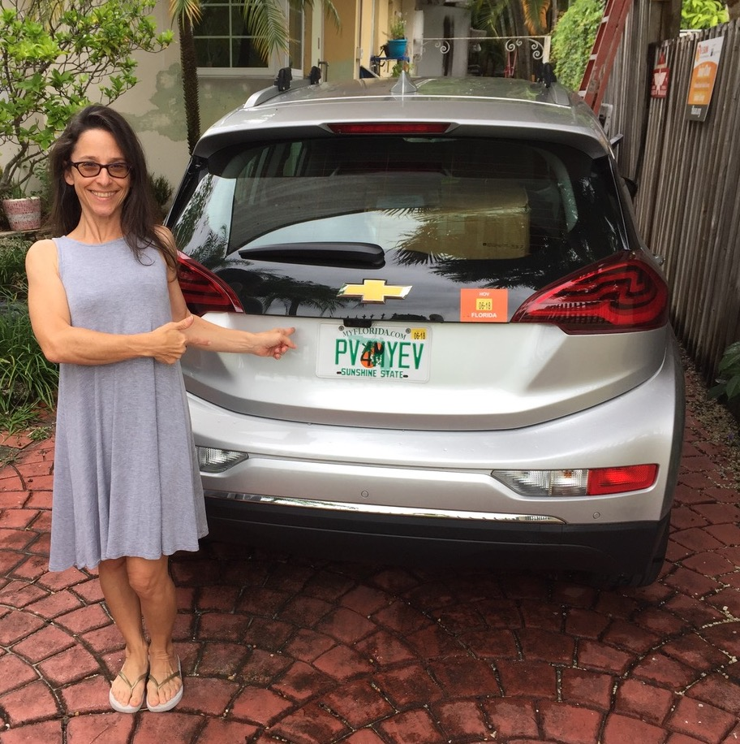
Thanks a million kilowatt hours!
Jody Finver
Miami-Dade Coordinator
jody@solarunitedneighbors.org

